Slide 1
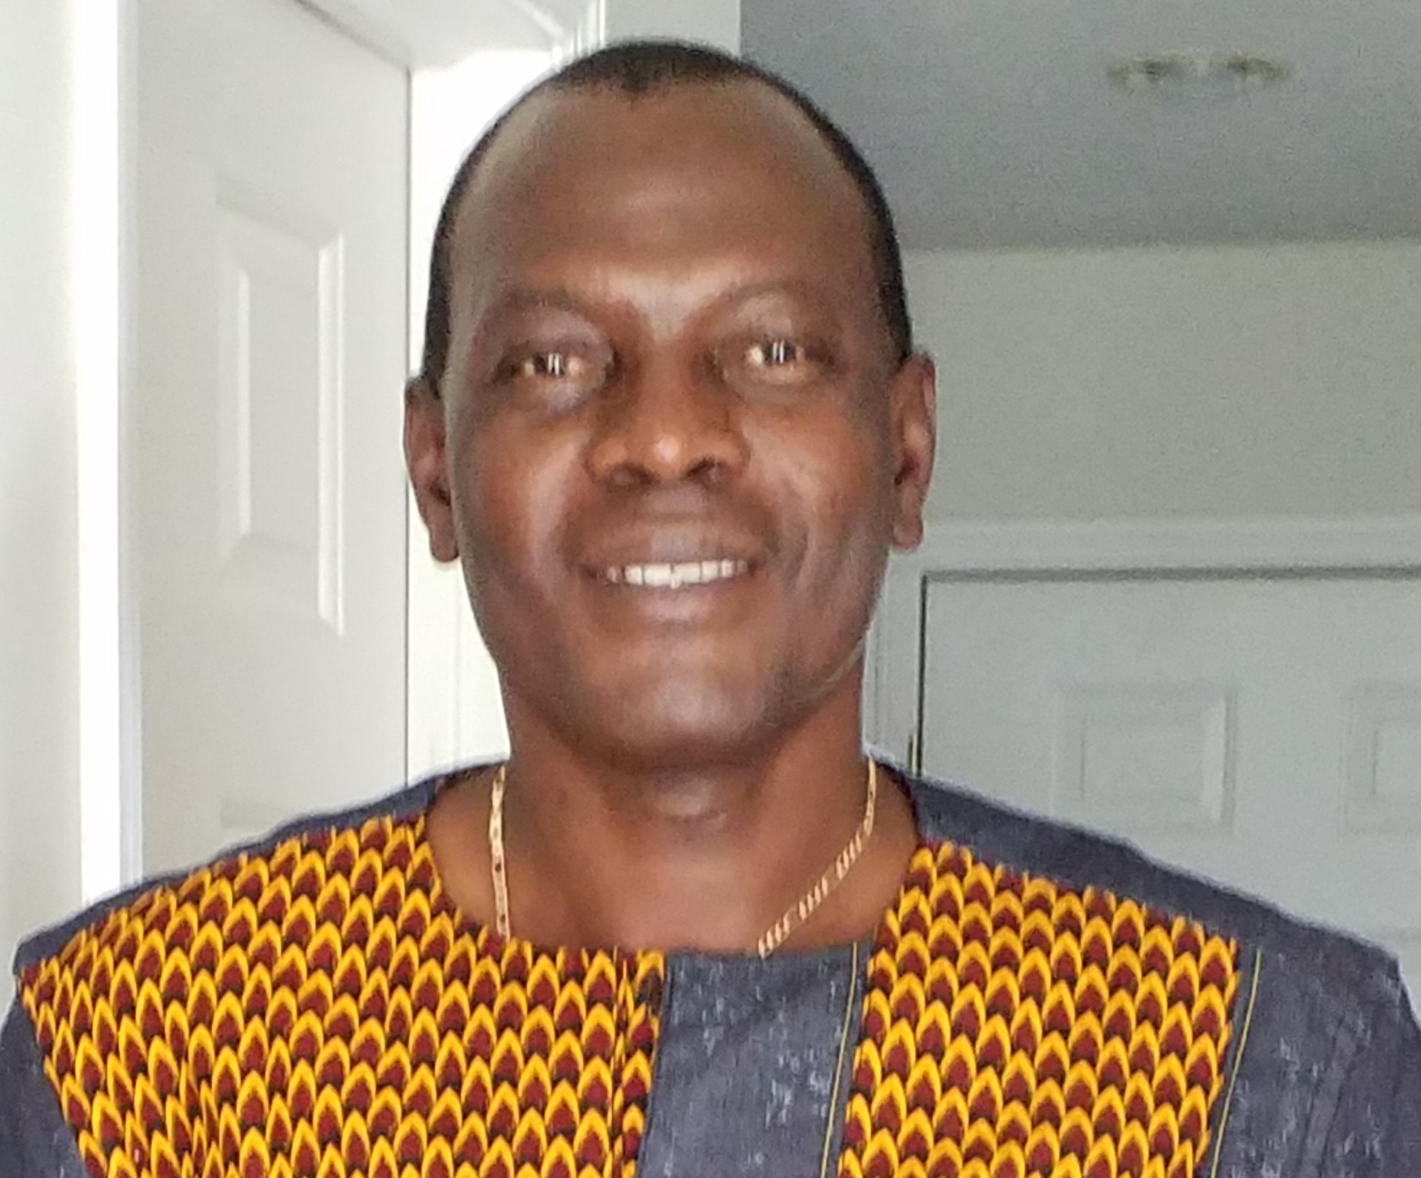
Ethics in Africa: Philosophical and Organizational Perspectives
Baniyelme D. Zoogah
A Maâtian perspective of ethics in Africa
Constant Beugré
Storytelling to ‘teach’ ethical values in Africa
Sherif Kamel
Ethics from modern Egyptian perspective
Masoud Shadnam
Descriptive research on moralities of organizational life in Africa
Professional Development Workshop
August 11, 2020 (10:00am to 12:00pm ET)
#11694 - Real-time Open
The workshop is intended to be a forum of interested researchers in preparation for proposing a special issue of Organization Studies and the Africa Journal of Management

