Slide 1
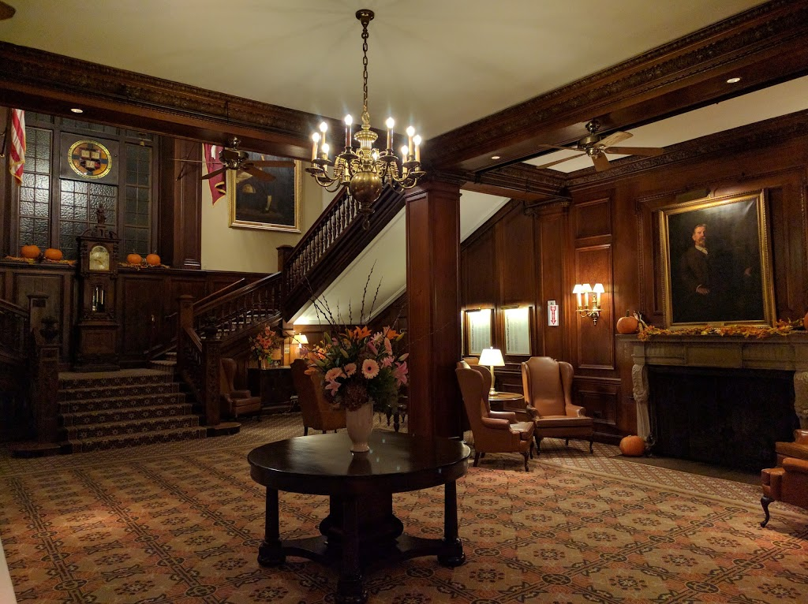
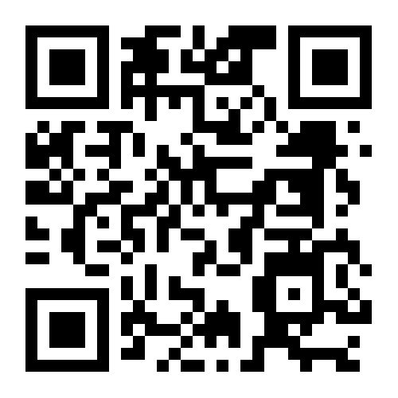
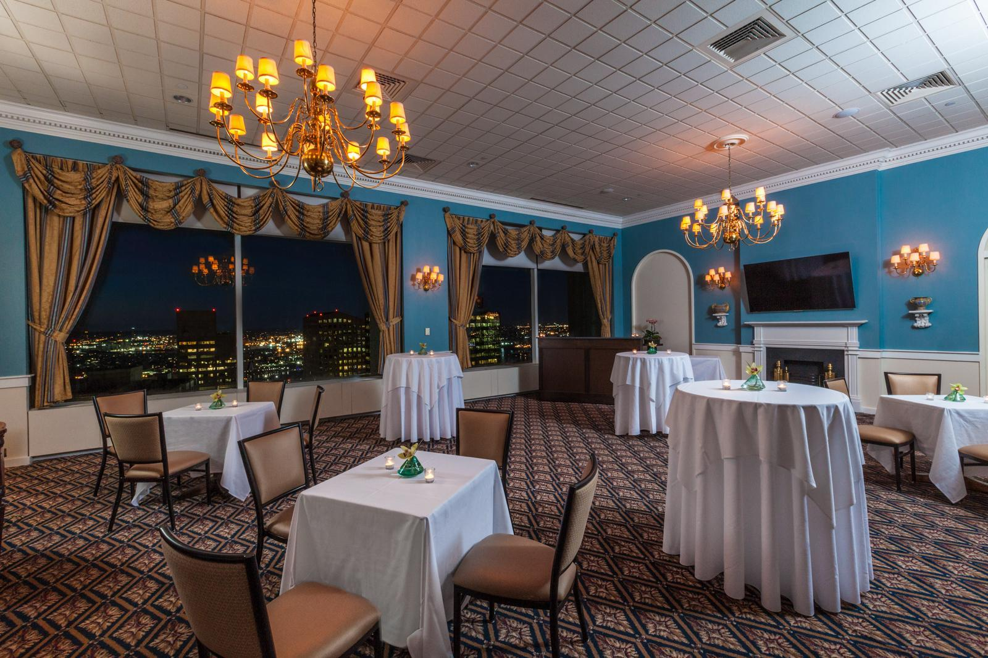
CM Division reception!
Your Social Director:
Pri Shah
Harvard Club
374 Commonwealth Avenue
7-9:30PM
Co-Sponsored by the Program on Negotiation (PON) at Harvard Law School
https://goo.gl/maps/9gRazFip7Pe6bjpg8

