Slide 1
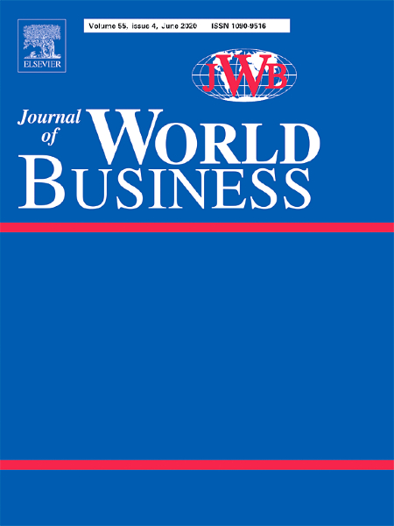
Journal of World Business
Ajai Gaur
Editor-in-Chief

Slide 2
Scope and Coverage
JWB is a premier journal in the field of international business.
JWB seeks submissions with an explicit multinational, cross-border, or international comparative orientation toward the study of management and organizations.
JWB publishes cutting-edge research that advances new ways of thinking about multinational firms and global phenomena.
JWB values contributions that explore and explicate implications for global enterprises and their managers, as well as consequences for public policy and society.
For more information, visit: https://www.journals.elsevier.com/journal-of-world-business

Slide 3
Impact Statistics and Rankings
2019 2-year Impact Factor: 5.194
2019 5-year Impact Factor: 6.774
2019 Cite Score: 11.9
About 800 submissions per year
7% acceptance rate
“A*” in ABDC list.
“4” in ABS list.
Ranked #2 in international business by Google Scholar
5-Year Impact Factor
2-Year Impact Factor
Cite Score

Slide 4
Comparison to select categories
2-Year Impact Factor vs. FT50
2-Year Impact Factor vs. IB Journals*
* Includes: JIBS, GSJ, IBR, JIM, MIR

Slide 5
Comparison to select categories
2019 Cite Score vs. FT50
2-Year Impact Factor of Top IB & Management Journals
 | All Cites | Without self-cites
Journal of International Business Studies | 9.16 | 6.69
Journal of Management | 8.88 | 8.61
Academy of Management Review | 8.41 | 7.87
Administrative Science Quarterly | 8.39 | 7.80
Academy of Management Journal | 7.57 | 7.07
Strategic Management Journal | 5.47 | 4.90
Journal of World Business | 5.19 | 4.70
Journal of Management Studies | 4.89 | 4.72
Global Strategy Journal | 4.07 | 3.91
International Business Review | 3.95 | 3.48
Journal of International Management | 3.82 | 3.04
Organization Science | 2.79 | 2.61
Management International Review | 2.02 | 1.83

Slide 6
JWB Welcomes Submissions from all Locations
Submitted Articles by Region (2019)

Slide 7
JWB Welcomes Submissions from Diverse Areas
Global Political and Economic Environment
Strategic Management
Organizational Behavior
Cross-Cultural Management
Leadership
Human Resources Management
Ethics, Social Responsibility, and Sustainability
Innovation, Technology, and Entrepreneurship
Organization Theory
International Marketing and supply chain management
International Finance and Accounting
Research Methods in IB

Slide 8
JWB on Social Media
Journal of World Business Page
https://www.facebook.com/JWBnews/
@JWBNews
Journal of World Business Group
https://www.linkedin.com/groups/8533855/profile
Social Media Coordinator, Vittoria Scalera - V.G.Scalera@uva.nl

